Slide 1
Estimating abundance
capture recapture
19-23 january 2015
UDEC, Concepción Chile

Slide 2
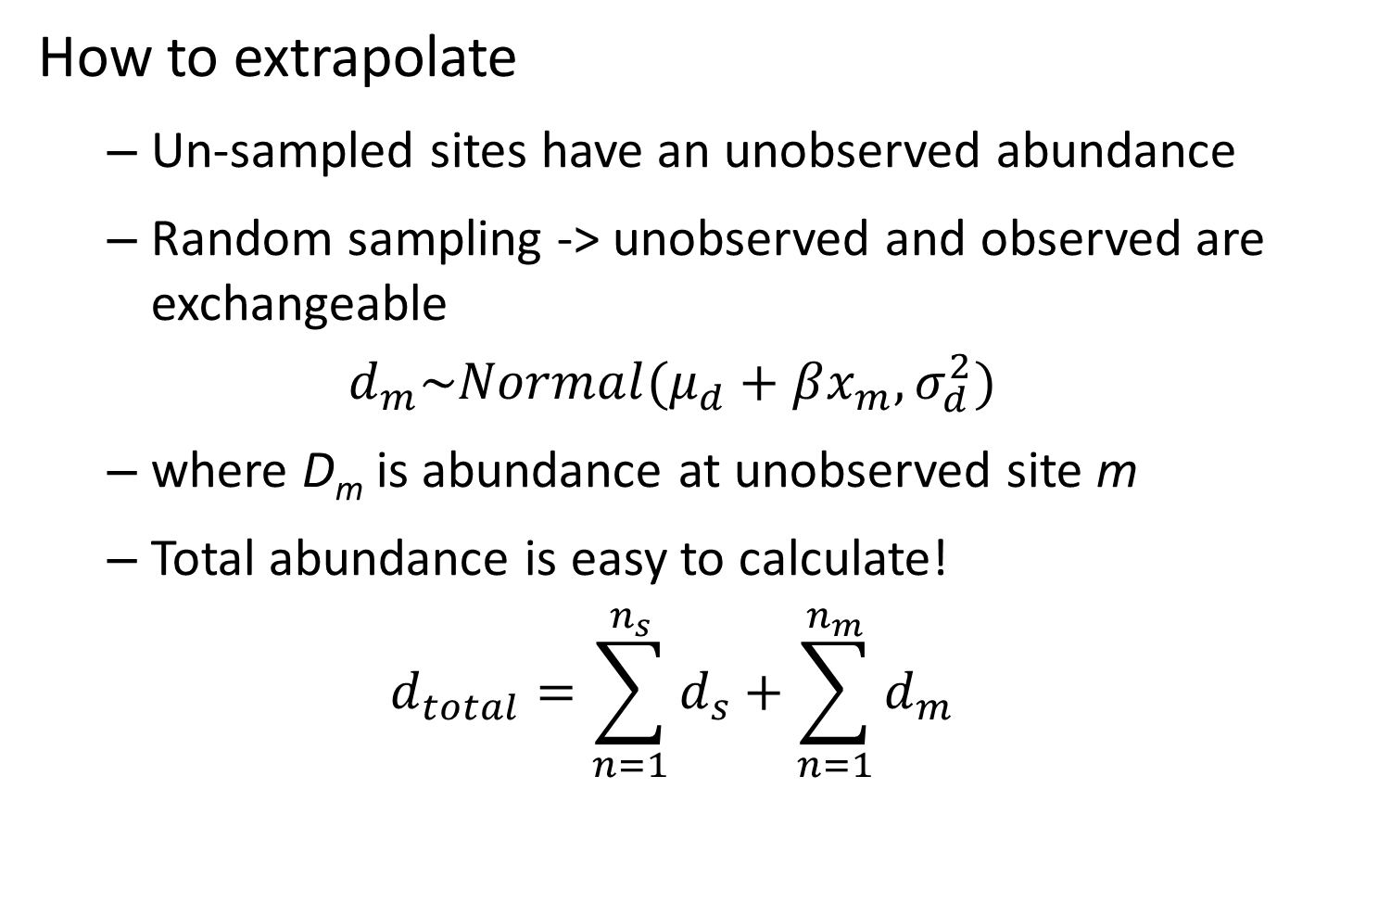
Estimating abundance
How to extrapolate
Un-sampled sites have an unobserved abundance
Random sampling -> unobserved and observed are exchangeable
$$d_{m}\sim Normal(μ_{d}+βx_{m},σ_{d}^{2})$$
where D_{m} is abundance at unobserved site m
Total abundance is easy to calculate!
$$d_{total}=\sum_{n=1}^{n_{s}}{d_{s}}+\sum_{n=1}^{n_{m}}{d_{m}}$$

Slide 3
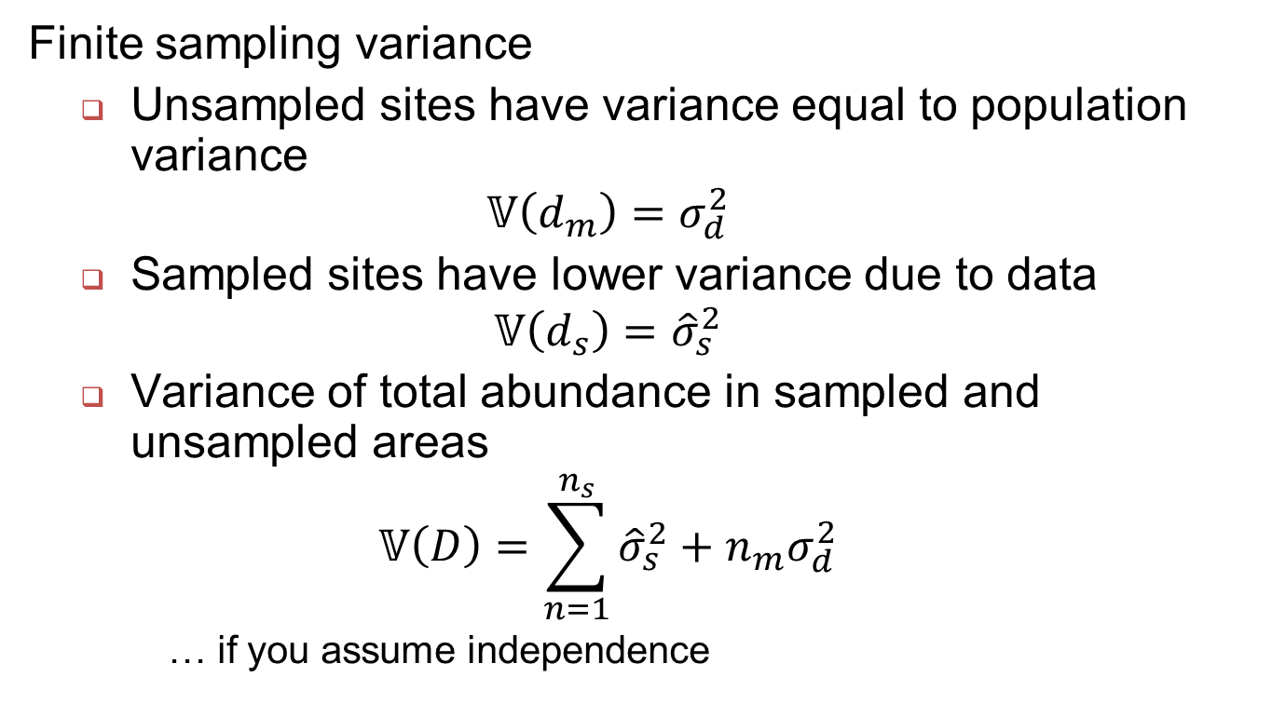
Estimating abundance
Finite sampling variance
Unsampled sites have variance equal to population variance
$$𝕍\left(d_{m}\right)=σ_{d}^{2}$$
Sampled sites have lower variance due to data
$$𝕍\left(d_{s}\right)={\hat{σ}}_{s}^{2}$$
Variance of total abundance in sampled and unsampled areas
$$𝕍\left(D\right)=\sum_{n=1}^{n_{s}}{{\hat{σ}}_{s}^{2}}+n_{m}σ_{d}^{2}$$
… if you assume independence

Slide 4
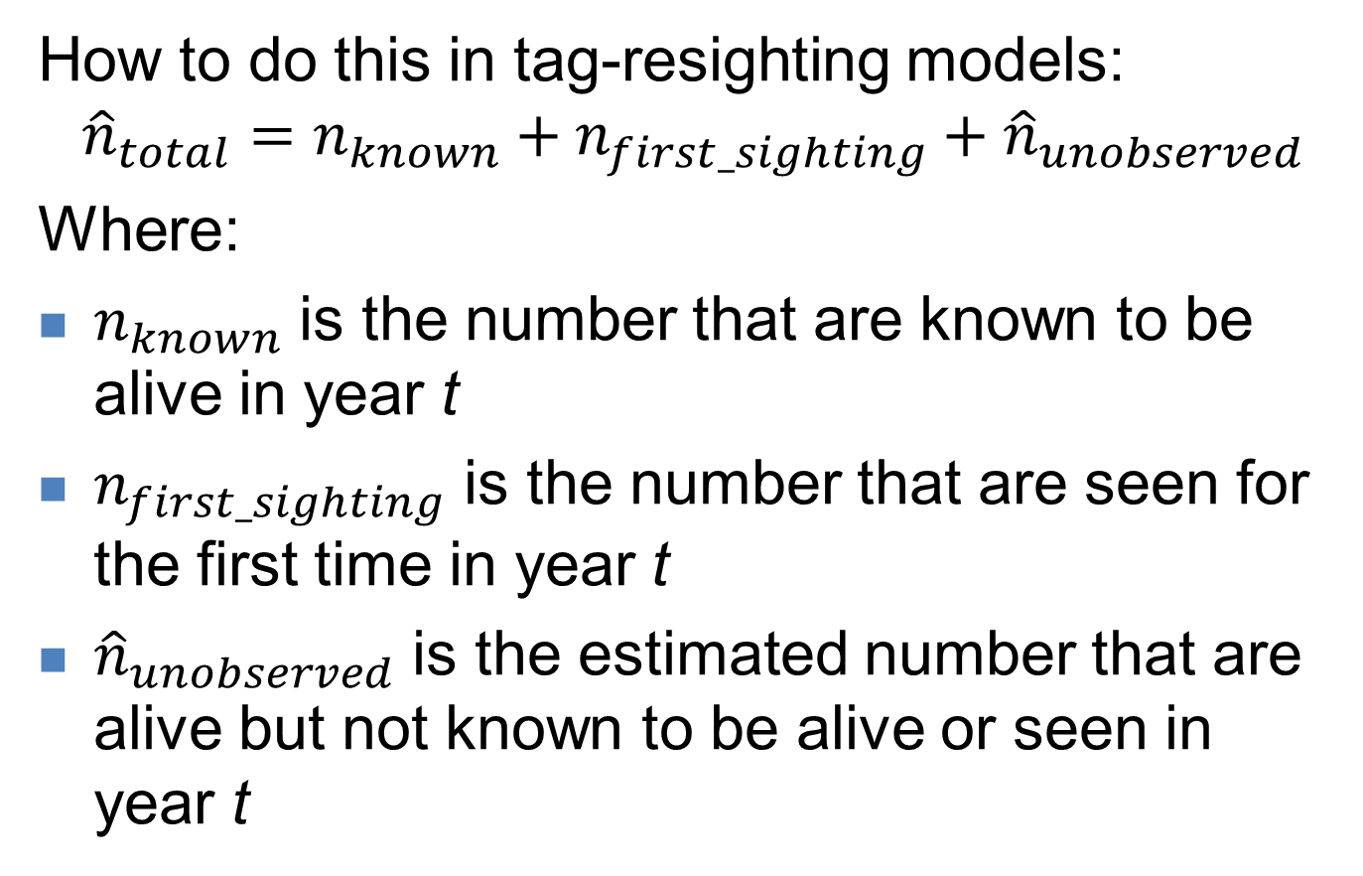
Estimating abundance
How to do this in tag-resighting models:
$${\hat{n}}_{total}=n_{known}+n_{first_sighting}+{\hat{n}}_{unobserved}$$
Where:
$n_{known}$ is the number that are known to be alive in year t
$n_{first_sighting}$ is the number that are seen for the first time in year t
${\hat{n}}_{unobserved}$ is the estimated number that are alive but not known to be alive or seen in year t

Slide 5
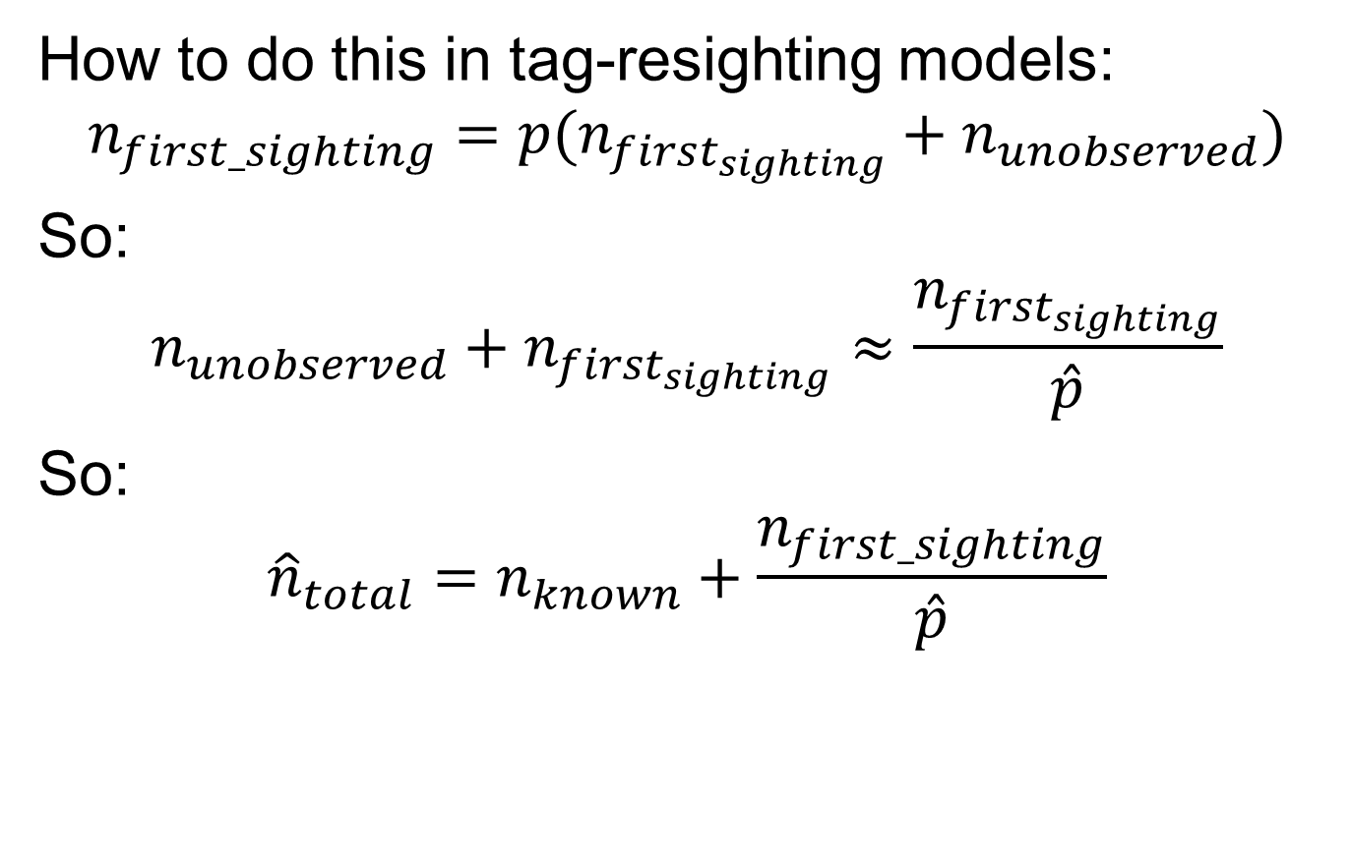
Estimating abundance
How to do this in tag-resighting models:
$$n_{first_sighting}=p(n_{first_{sighting}}+n_{unobserved})$$
So:
$$n_{unobserved}+n_{first_{sighting}}≈\frac{n_{first_{sighting}}}{\hat{p}}$$
So:
$${\hat{n}}_{total}=n_{known}+\frac{n_{first_sighting}}{\hat{p}}$$

Slide 6
Estimating abundance
Ways to improve this
Smooth estimates of detection probability
Model dynamics for each individual (births + deaths + detections = Jolly-Seber model)

